Slide 1

Welcome
to
My Presentation

Slide 2

BGC Trust University Bangladesh
Department of Journalism & Media Studies
Course Title: ICT and New Media
Course Code: JMS-209
Presentation Topic: Advantages & Disadvantages of Social Media
Presented to:
Prof. Dr. Mohammad Ali Asgar Chowdhury, Adjunct Faculty
Department of JMS
BGC Trust University Bangladesh
Presented by:
Kuslob Kumar Nath
Roll no: 221204004
Department of JMS
BGC Trust University Bangladesh

Slide 3


Slide 4
Advantages of Social Media
Connectivity
Advantages
Global Awareness
Information Sharing
Marketing & Branding
Networking

Slide 5

01.Connectivity:
Social media allows people to connect with
friends, family and acquaintance regardless
of geographical boundaries.

Slide 6

02. Information Sharing:
It is a powerful platform for
sharing news, information, and
updates making it a valuable
source of knowledge.

Slide 7

03. Networking:
Students can build professional
networks and connect with potential
mentors and employers on platforms
like Linkedin.

Slide 8

04. Marketing & Branding:
Businesses and individuals can use
social media for marketing, promoting
products, and building personal or
professional brands.

Slide 9

05. Global Awareness:
It raises awareness about global
issues , making it easier to mobilize
support for causes.

Slide 10
Disadvantages of Social Media
Privacy Concerns
Disadvantages
Time Wasting
Cyberbullying
Fake News
Addiction

Slide 11

01.Privacy Concerns:
Users often share personal information,
which can lead to privacy breaches and
identity theft.

Slide 12
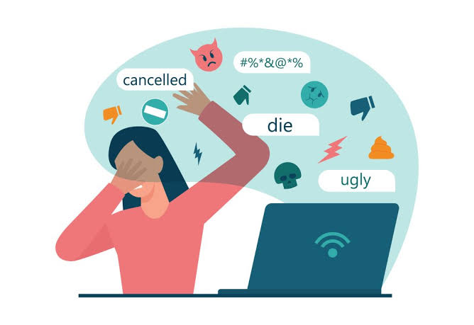
02. Cyberbullying:
Social media can be a platform for
cyberbullying, leading to psychological
distress and harm to individuals.

Slide 13
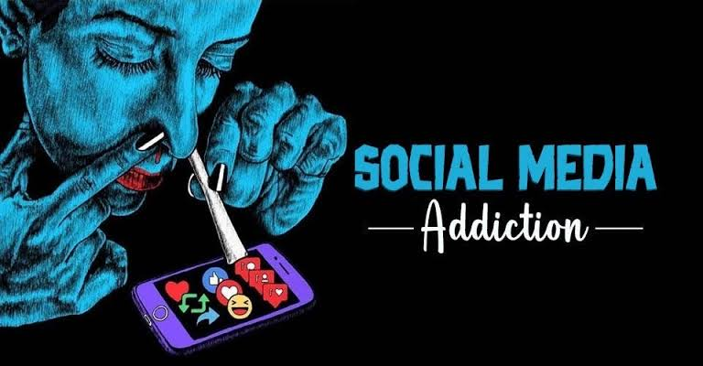
03.Addiction:
Excessive use of social media
can lead to addiction, affecting
productivity and mental health.

Slide 14

04.Fake News:
Misinformation spreads easily on
social media, which can have serious
consequences, especially
during crises.

Slide 15

05.Time Wasting:
Excessive use of social media can
detract from academic or
professional responsibilities.

Slide 16
Question & Answer
?

Slide 17
Thank You

